Slide 1
Welcome to
A LEVEL MEDIA STUDIES

Slide 2
Bridging Work
Instructions:
Read the course outline on slides 3-9 so you understand the course requirements.
Complete tasks 1-5, found on slides 10-17
Complete the summer task, found on slide 18

Slide 3
Course Outline
The examination board you are studying is WJEC/Eduqas.
The Qualification is GCE A Level in Media Studies.
Component 1: Media Products, Industries and Audiences
Written examination: 2 hours 15 minutes
35% of qualification
Component 2: Media Forms and Products in Depth
Written examination: 2 hours 30 minutes
35% of qualification
Component 3: Cross-Media Production
Non exam assessment
30% of qualification

Slide 4
Component 1
Section A: Analysing Media Language and Representation (45 marks)
One question will assess media language and will require analysis of an unseen audio-visual or print resource from any of the media forms studied for this section.
One question will assess representation. The question will require comparison of one set product and an unseen audio-visual or print resource from any of the forms studied for this section through an extended response.
Examples of set texts: Kiss of the Vampire, Tide, Superhuman, Black Panther, I Daniel Blake , Alicia Keys, Sam Fender, Daily Mirror, The Times , Assassins Creed, George's Podcast

Slide 5
Component 1
Section B: Understanding Media Industries and Audiences (45 marks)
Question 3 will be a stepped question assessing knowledge and understanding of media industries in relation to one form studied.
Question 4 will be a stepped question assessing knowledge and understanding of audiences in relation to a different media form from that assessed in question one.

Slide 6
Component 2
In this component learners are required to study three media forms in depth,
exploring all areas of the theoretical framework - media language, representation, media industries, and audiences - in relation to audio-visual, print and online products set by WJEC.
The forms to be studied in depth are:
Television-Section A: Television in the Global Age
Magazines-Section B: Magazines – Mainstream and Alternative Media
Blogs and websites-Section C: Media in the Online Age
Examples of set texts: Black Mirror, The Returned, Vogue, The Big Issue, Zoella and Attitude

Slide 7
Component 2
Assessment
The exam consists of three sections:
Section A: Television in the Global Age (30 marks)
There will be one two-part question or one extended response question.
Section B – Magazines: Mainstream and Alternative Media (30 marks)
There will be one two-part question or one extended response question.
Section C – Media in the Online Age (30 marks)
There will be one two-part question or one extended response question.

Slide 8
Component 3
Coursework
Individual Assessment
Choice of briefs set by WJEC/Eduqas
Media forms will always be: TV, Advertising and Marketing: Music, Magazines and Film.
Cross media production for example: film posters, a DVD cover and an Audio podcast or an Audio Visual promotional video.
Research and Planning
Statement of aims
Production and editing

Slide 9
Component 3
Assessment
Assessment
The total number of marks available is 60:
10 marks for the statement of aims and intentions.
20 marks for creating a cross-media production that meets the requirements of the set brief, including suitability for the chosen form, genre, industry context and audience.
30 marks for creating a cross-media production which uses media language to communicate meanings and construct representations.

Slide 10
Theoretical Framework
Media language: how media language, codes, conventions and techniques
create meanings
Representation: how the media represent events, issues, places and
social/cultural groups
Media industries: processes of production, distribution and circulation
Audiences: how different audiences/users respond to and interact with media
products and processes.

Slide 11
Task 1
What do we mean when we talk about the media?
Brainstorm the media.
Bridging Work

Slide 12
Task 1
What do we mean when we talk about the media forms?
advertisements
DVD covers
computer game extracts
CD covers
media
websites
newspaper front pages
Music videos
magazines and comics
television sequences
radio sequences
film extracts

Slide 13
MIGRAIN
Media Language
Institutions
Genre
Representation
Audience
Ideology
Narrative
 Explore the key concepts above and when answering an examination question, make good use of the key concepts throughout your answer

Slide 14

Task 2
Let’s start by reading a text
Have a go at deconstructing this CD cover

Slide 15
Task 2
Reading a text… some clues
Name of the artist
Narrative
Title of the CD
Codes & Conventions
Dominant Image
Nostalgia
Mise-en-scene
Representation
Dominant Colour
Logo
Patriotism
Football references
Genre of image
Hero
Audience
Genre of Music
 When you come across a word or term that you don’t understand write it in the back of your book and find out what it means and then write its definition next to it.

Slide 16
Representation of Social Groups
We often analyse representations in the media according to categories such as:
    Age
    Disability
    Gender
    Socio-economic grouping
    Race
    Nationality
    Sexuality
When looking at representation we need to consider how people are portrayed in each of their groups for example:
  Women
  Old people
  Travellers
  Football supporters

Slide 17

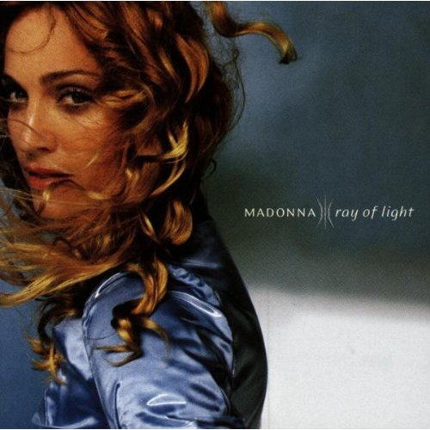

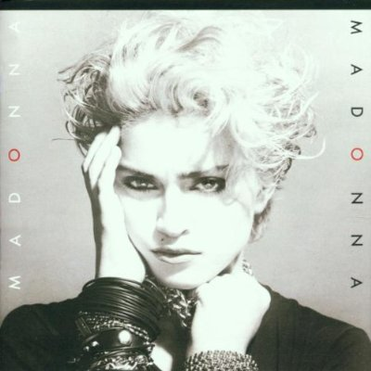
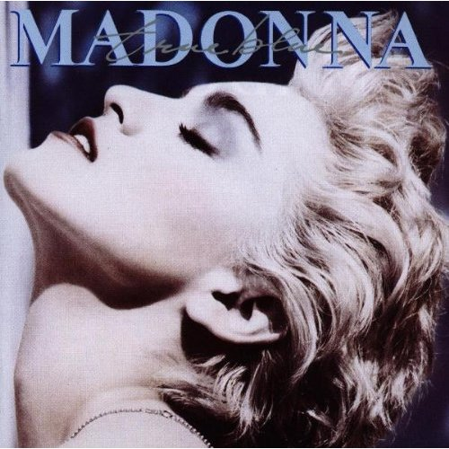
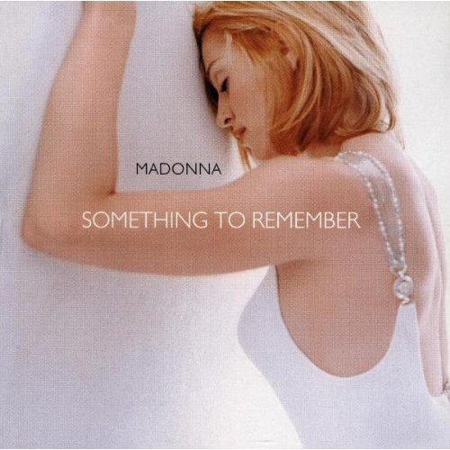
REPRESENTATION
How is Madonna represented in each of these images?
Why have these CD covers been constructed in this way?
How does the audience receive these representations?
Task 3
Look at the six images and consider how Madonna is represented in each of them

Slide 18
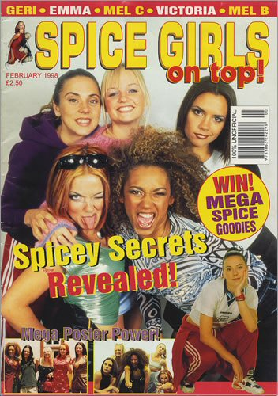
Stereotypes
Stereotypes are characters in a media text who are ‘types’ rather than complex people
Stereotypes are usually defined by their role
Stereotypes are often negative representations
Task 5
What were the stereotypes that were constructed for the Spice Girls?
Why do you think this was?

Slide 19

Summer Task
Read the following media text or an album cover of your choice and
write up a complete analysis using all of the information you have
learnt today.

